Slide 1
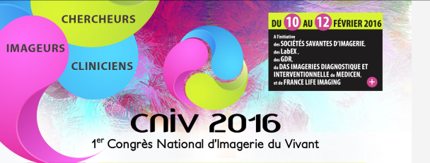
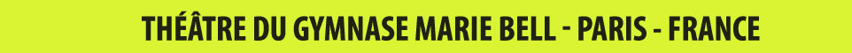
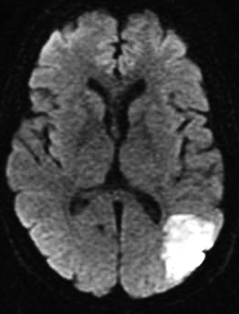
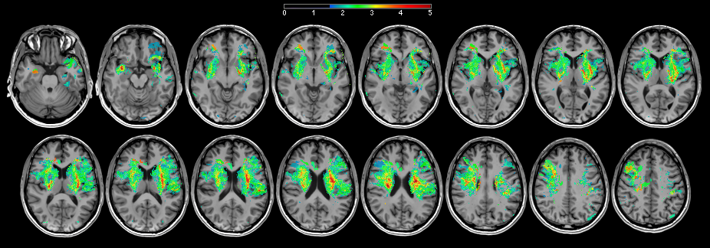
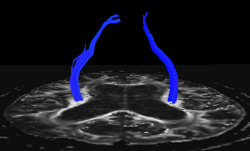



Imaging biomarkers of post-stroke prognosis
Thomas Tourdias ^{1, 2}
NeuroImaging department, Bordeaux University Hospital
Neurocentre Magendie, team “Glia-Neuron interactions”, INSERM U1215, Bordeaux University

Slide 2

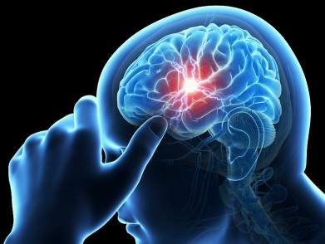

General introduction Rationale
ISCHEMIA
DISABILITY / HANDICAP
Sub-acute
Chronic
To inform patients and caregivers
To anticipate the type, duration and goals of rehabilitation.
To improve patient selection for clinical trials focusing on brain repair

Slide 3

General introduction Rationale
ISCHEMIA
DISABILITY / HANDICAP
Sub-acute
Chronic
CLINICAL PREDICTORS
Age
Initial clinical severity

Slide 4
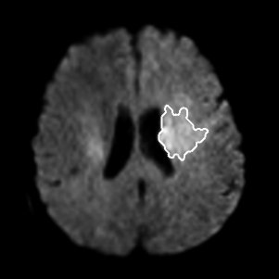
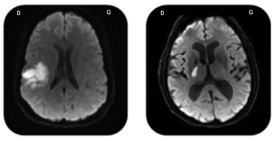
General introduction Rationale
ISCHEMIA
DISABILITY / HANDICAP
Sub-acute
Chronic
CLINICAL PREDICTORS
Age
Initial clinical severity
IMAGING PREDICTORS
Stroke volume

Slide 5
General introduction Rationale
ISCHEMIA
DISABILITY / HANDICAP
Sub-acute
Chronic
CLINICAL PREDICTORS
Age
Initial clinical severity
IMAGING PREDICTORS
Stroke volume
Stroke location
Hypothesis
Quantification of stroke location (more or less complete destruction of a more or less eloquent area) improves the prediction of medium-to-long term outcome.

Slide 6
Methods Prospective cohort
“BBS” (Brain Before Stroke) study
Funding: “PHRC inter-regional 2012”
Prospective
350 patients
MRI
Clinical
evaluation
MRI
Clinical
evaluation
MRI
Clinical
evaluation
MRI
Clinical
evaluation
24h-72h
3 months
6 months
1 year
Stroke location
COGNITIVE outcome
?

Slide 7
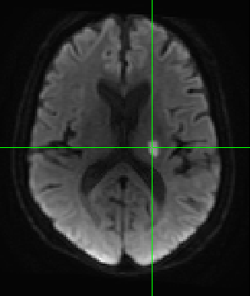
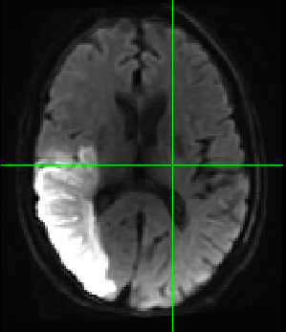
Stroke location and cognitive outcome Maps of eloquent regions
Segmentation of stroke
Normalization within the MNI space
Voxel-based Lesion-Symptom Mapping
n = 215 patients
n patients with this given voxel infarcted
n’ patients with this given voxel spared
Mean score of MoCA
Mean score of MoCA
Comparison
Z score

Slide 8
Stroke location and cognitive outcome Maps of eloquent regions
Item “naming” from MoCA
Item “language” from MoCA
Item “visuospatial and executive” from MoCA
Item “delayed recall” from MoCA

Slide 9
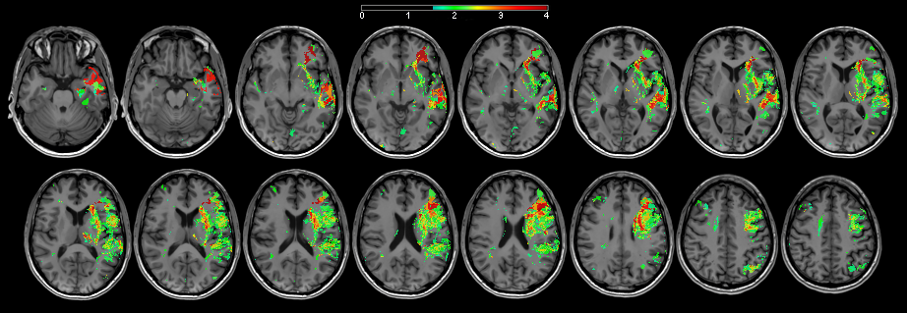
Stroke location and cognitive outcome Maps of eloquent regions
Atlas : Cognitive eloquent areas

Slide 10
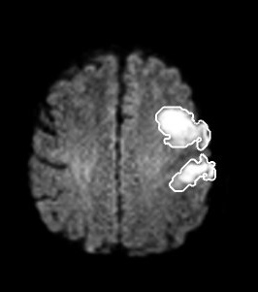
Stroke location and cognitive outcome Extraction of location-based variables
Atlas : Cognitive eloquent areas
Location = number of eloquent voxels that survived a 5% false discovery rate cutoff threshold

Slide 11
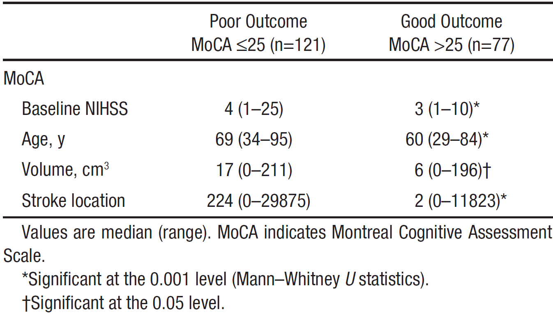
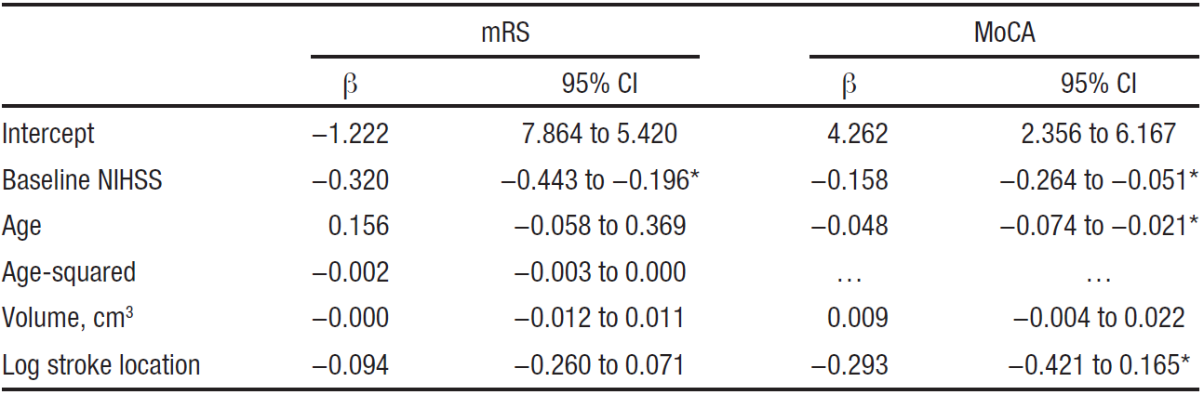
Stroke location and cognitive outcome Prediction models
Univariate
Multivariate (predictors of good cognitive outcome)

Slide 12
Stroke location and cognitive outcome Prediction models
Development sample n=215
Replication sample n=69
with location
AUC=0.771
with location
AUC=0.779
Sensitivity
Sensitivity
without location
AUC=0.697
without location
AUC=0.660
1-Specificity
1-Specificity
Significant added value of stroke location
Differences of AUC =0.12
p=0.005

Slide 13

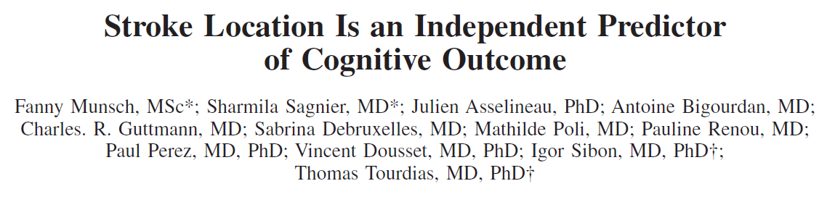
Stroke location and cognitive outcome Prediction models
MRI
Clinical
evaluation
MRI
Clinical
evaluation
MRI
Clinical
evaluation
MRI
Clinical
evaluation
24h-72h
3 months
6 months
1 year
Stroke location
MOTOR outcome
?

Slide 14
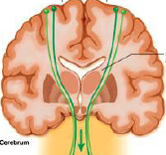
Stroke location and motor outcome Maps of eloquent regions
Atlas : Motor eloquent areas
 | mFugl-Meyer
 | Poor outcome mFugl-Meyer ≤84 (n=40) | Good outcome mFugl-Meyer >84 (n=167)
Baseline NIHSS | 15 (1-25) | 3 (1-24)†
Age, y | 77 (46-95) | 66 (29-88)†
Volume, cm³ | 38 (1-211) | 12 (0-196)†
Stoke location | 128 (0-2690) | 3 (0-1880)†
Difference of AUC =0.028 ; 95% CI = [-0,003; 0,068]
p=ns

Slide 15
Stroke location and motor outcome Hypotheses
Hypotheses
Clinical severity is already a strong predictor: interest of stroke location for a targeted sub-population?
Quantification of stroke location (more or less complete destruction of a more or less eloquent area) improves the prediction of medium-to-long term outcome.
Structural integrity of the pyramidal tract as assessed from early MRI improves the prediction of motor outcome over that provided by initial clinical severity

Slide 16
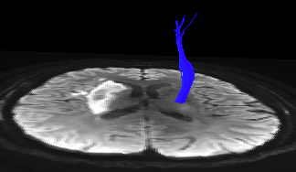
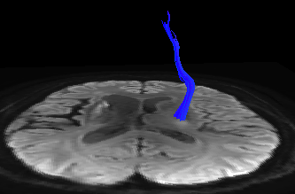
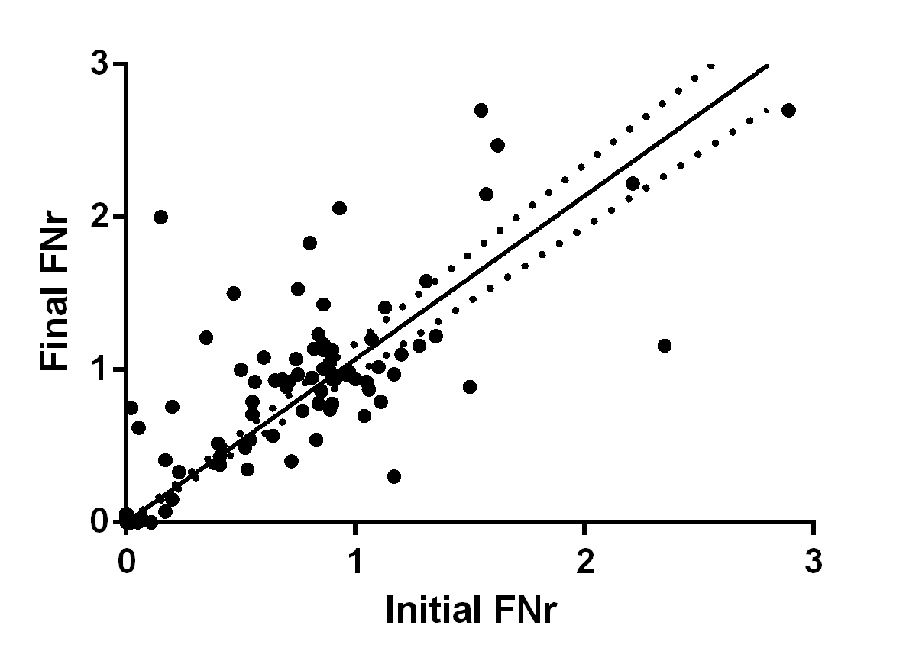
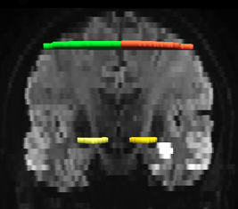
Stroke location and motor outcome Early assessment of motor fiber integrity
Structural integrity of the pyramidal tract as assessed from early MRI improves the prediction of motor outcome over that provided by initial clinical severity
MRI
Clinical
evaluation
MRI
Clinical
evaluation
24h-72h
1 year
iFNr: initial fiber number ratio
r=0.7; p<0.0001
fFNr: final fiber number ratio

Slide 17
Stroke location and motor outcome Prediction of motor recovery by using initial clinical severity
Structural integrity of the pyramidal tract as assessed from early MRI improves the prediction of motor outcome over that provided by initial clinical severity
Y ≈ 0.7 x

Slide 18
Stroke location and motor outcome Added value of iFNr compared to initial Fugl-Meyer
Structural integrity of the pyramidal tract as assessed from early MRI improves the prediction of motor outcome over that provided by initial clinical severity
Fugl-Meyer =12/100
iFNr=0
Fugl-Meyer =12/100
fFNr=0
Fugl-Meyer =26/100
iFNr=0.4
Fugl-Meyer =79/100
fFNr=0.52

Slide 19
Stroke location and motor outcome Added value of iFNr compared to initial Fugl-Meyer
Structural integrity of the pyramidal tract as assessed from early MRI improves the prediction of motor outcome over that provided by initial clinical severity
Fugl-Meyer =12/100
iFNr=0
Fugl-Meyer =12/100
fFNr=0
Fugl-Meyer =26/100
iFNr=0.4
Fugl-Meyer =79/100
fFNr=0.52

Slide 20
Stroke location and motor outcome Added value of iFNr compared to initial Fugl-Meyer
Structural integrity of the pyramidal tract as assessed from early MRI improves the prediction of motor outcome over that provided by initial clinical severity
Subpopulation of mild-to-moderate patients (n=91)
Subpopulation of severe patients (n=26)
y=0.7x

Slide 21
Stroke location and motor outcome Added value of iFNr compared to initial Fugl-Meyer
Structural integrity of the pyramidal tract as assessed from early MRI improves the prediction of motor outcome over that provided by initial clinical severity
Subpopulation of severe patients (n=26)
y=0.67x

Slide 22
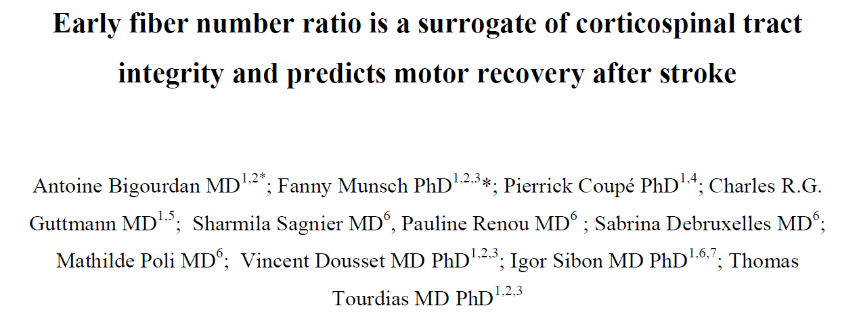
Stroke location and motor outcome Conclusion
Accepted paper
iFNr measured between 24-72h after the insult provides an early surrogate of chronic pyramidal tract degeneration
iFNr provides significant independent added value toward predicting long-term motor impairment
This is especially relevant for severely affected patients who demonstrate highly variable recovery

Slide 23
Imaging and prognosis Conclusion
ISCHEMIA
DISABILITY / HANDICAP
Sub-acute
Chronic
CLINICAL PREDICTORS
Age
Initial clinical severity
IMAGING PREDICTORS
Stroke volume
Stroke location
Perspectives
Transcranial magnetic stimulations
Plasticity and fMRI

Slide 24




Thank you…
NeuroImaging department: Pr Dousset, Bordeaux
Neurocentre Magendie INSERM U862: Dr Oliet, Bordeaux
Stroke department: Pr Sibon, Bordeaux
Students: Fanny Munsch, Antoine Bigourdan
FINANCIAL SUPPORT

